Slide 1
Intel College Excellence Program
Data Analytics Tools : Numpy

Slide 2
Introduction
NumPy is the core library for scientific computing in Python.
It contains among other things:
a powerful N-dimensional array object and tools for working with these arrays
sophisticated (broadcasting) functions
tools for integrating C/C++ and Fortran code
useful linear algebra, Fourier transform, and random number capabilities
Besides its obvious scientific uses, NumPy can also be used as an efficient multi-dimensional container of generic data.

Slide 3
Why Numpy
List is powerful, collection of values
Hold different types and you can change, add or remove elements from the list
But for data scientist you need to apply operations on entire array
Mathematical operations on entire collection of data set/list/arrays
Speed Solution is numpy (numerical python): you can perform operations on entire arrays.

Slide 4
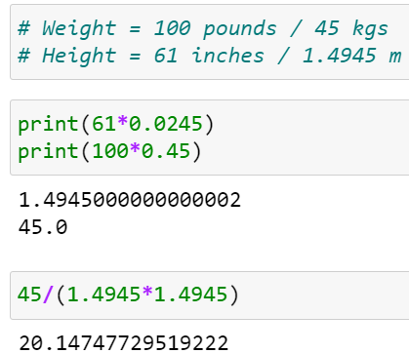
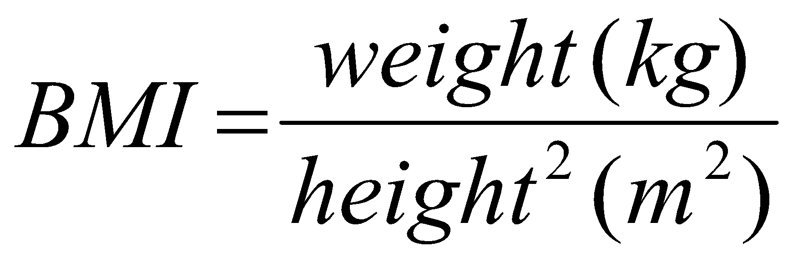
Broadcasting in Numpy

Slide 5
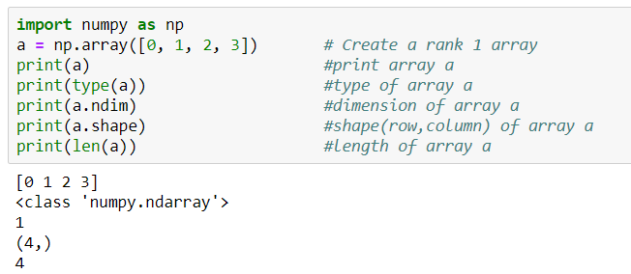
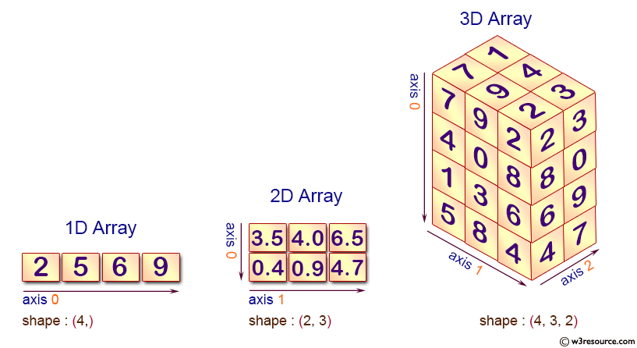
Numpy Array
Scalar
Vector
Matrix
Tensor

Slide 6
Working with array’s in Numpy
Create 2-D array using numpy from list
import numpy as np
mylist=[[1,2,3],[4,5,6],[7,8,9]]
np.array(mylist)
Create 1-D and 2-D array using random values
np.random.rand(5) #uniform distribution of random values
np.random.rand(4,4) # create 2-D array of random values
np.random.randn(4) #std. normal distribution, centered around 0

Slide 7
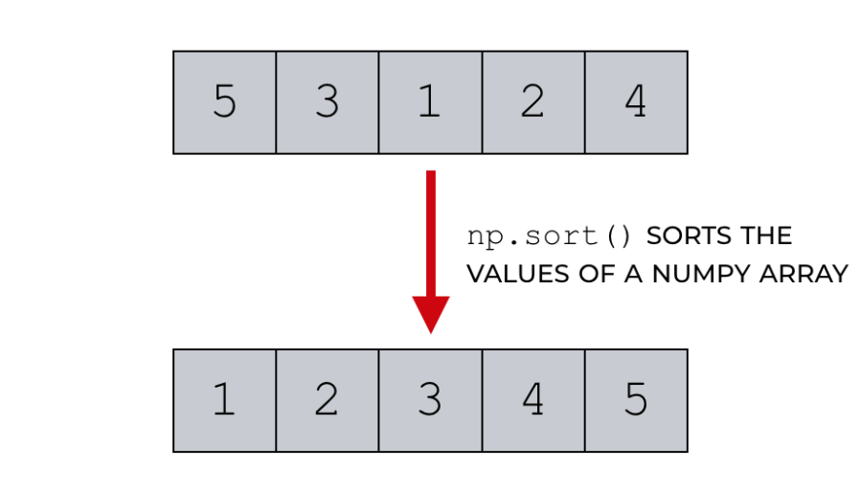
Numpy Methods and Attributes
np.array()
np.random.randint(0,10,1)
np.unique()
np.dot()
np.power(a,2)
np.sqrt(a)
np.ones()
np.zeros()
np.max()
np.arange(10)
a.size
a.ndim
a.dtype
a.shape

Slide 8
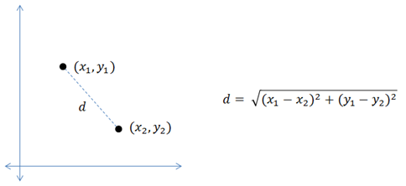
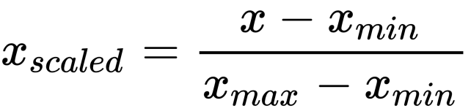
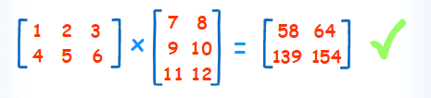

Numpy Operations
1. Euclidean Distance
2. Normalization using Min Max Scalar
3. Matrix Multiplication (Dot Product)
4. Mean Squared Error

Slide 9
Statistical Functions
np.amin() & np.amax() return the minimum and the maximum from the elements in the given array along the specified axis.
a = np.array([[3,1,5],[9,4,3],[2,4,6]])
print ‘Input Array is:'
print a
print '\n’
print 'Applying amin() function:'
print np.amin(a,1)
print '\n'

Slide 10
Statistical Functions
print 'Applying amin() function again:'
print np.amin(a,0)
print '\n'
print 'Applying amax() function:'
print np.amax(a)
print '\n'
print 'Applying amax() function again:'
print np.amax(a, axis = 0)

Slide 11
Statistical Functions
numpy.ptp() function returns the range (maximum-minimum) of values along an axis.
a = np.array([[3,7,5],[8,4,3],[2,4,9]])
print ‘Input Array is:'
print a
print '\n'
print 'Applying ptp() function:'
print np.ptp(a)
print '\n'
print 'Applying ptp() function along axis 1:'
print np.ptp(a, axis = 1)
print '\n'
print 'Applying ptp() function along axis 0:'
print np.ptp(a, axis = 0)

Slide 12
Statistical Functions
numpy.percentile() indicates the value below which a given percentage of observations in a group of observations fall.
a = np.array([[20,40,80],[70,20,20],[50,30,60]])
print ‘Input Array is:'
print a
print '\n'
print 'Applying percentile() function:'
print np.percentile(a,50)
print '\n'
print 'Applying percentile() function along axis 1:'
print np.percentile(a,50, axis = 1)
print '\n'
print 'Applying percentile() function along axis 0:'
print np.percentile(a,50, axis = 0)

Slide 13
Statistical Functions
numpy.median() is defined as the value separating the higher half of a data sample from the lower half.
a = np.array([[30,55,70],[80,85,10],[60,90,20]])
print ‘Input Array is:'
print a
print '\n'
print 'Applying median() function:'
print np.median(a)
print '\n'
print 'Applying median() function along axis 0:'
print np.median(a, axis = 0)
print '\n'
print 'Applying median() function along axis 1:'
print np.median(a, axis = 1)

Slide 14
Statistical Functions
The numpy.mean() function returns the arithmetic mean of elements in the array. If the axis is mentioned, it is calculated along it.
a = np.array([[1,2,3],[4,5,6],[7,8,9]])
print ‘Input Array is:'
print a
print '\n'
print 'Applying mean() function:'
print np.mean(a)
print '\n'
print 'Applying mean() function along axis 0:'
print np.mean(a, axis = 0)
print '\n'
print 'Applying mean() function along axis 1:'
print np.mean(a, axis = 1)

Slide 15
Statistical Functions
Standard deviation is the square root of the average of squared deviations from mean. The function used for this is np.std(). The formula for standard deviation is as follows −
std = sqrt(mean(abs(x - x.mean())**2))
print np.std([1,2,3,4])
Variance is the average of squared deviations, i.e., mean(abs(x - x.mean())**2).
Or, standard deviation is the square root of variance.
print np.var([1,2,3,4])

Slide 16
Sort Function
The np.sort() function returns a sorted copy of the input array.
a = np.array([[3,7],[9,1]])
print ‘Input Array is:'
print a
print '\n'
print 'Applying sort() function:'
print np.sort(a)
print '\n'
print 'Sort along axis 0:'
print np.sort(a, axis = 0)
print '\n'
# Order parameter in sort function
dt = np.dtype([('name', 'S10'),('age', int)])
a = np.array([("ram",22),("anoop",35),("raj", 18), ("amir",29)], dtype = dt)
print ‘Input Array is:'
print a
print '\n'
print 'Order by name:'
print np.sort(a, order = 'name')

Slide 17
np.extract() function
The np.extract() function returns the elements satisfying any condition.
x = np.arange(9.).reshape(3, 3)
print 'Our array is:'
print x
# define a condition
condition = np.mod(x,2) == 0
print 'Element-wise value of condition'
print condition
print 'Extract elements using condition'
print np.extract(condition, x)

Slide 18
Iterating Over Array
NumPy package contains an iterator object numpy.nditer.
It is an efficient multidimensional iterator object using which it is possible to iterate over an array.
a = np.arange(0,60,5)
a = a.reshape(3,4)
print 'Original array is:'
print a
print '\n'
print 'Modified array is:'
for x in np.nditer(a):
print x

Slide 19
Iterating Over Array
a = np.arange(0,60,5)
a = a.reshape(3,4)
print 'Original array is:'
print a
print '\n'
for x in np.nditer(a, op_flags = ['readwrite’]): # default: read-only ; enable modifying array elements
x[...] = 2*x
print 'Modified array is:'
print a

Slide 20
Rounding Functions
numpy.around() is a function that returns the value rounded to the desired precision.
a = np.array([1.2,1.23, 199, 0.245, 25.123])
print ‘Input array:'
print a
print '\n'
print 'After rounding:'
print np.around(a)
print np.around(a, decimals = 1)
print np.around(a, decimals = -1)

Slide 21
Rounding Functions
numpy.floor() returns the largest integer not greater than the input parameter. The floor of the scalar x is the largest integer i, such that i <= x.
a = np.array([-1.6, 1.8, -0.4, 0.3, 7])
print ‘Input array:'
print a
print '\n'
print 'The modified array:'
print np.floor(a)

Slide 22
Rounding Functions
The ceil() function returns the ceiling of an input value, i.e. the ceil of the scalar x is the smallest integer i, such that i >= x.
import numpy as np
a = np.array([-1.6, 1.8, -0.4, 0.3, 7])
print ‘Input array:'
print a
print '\n'
print 'The modified array:'
print np.ceil(a)

Slide 23
Playing with Data
arr=np.arange(0,11) # create array of 10 elements between 1—10
arr[:5] # fetch 1st 5 elements of array arr
arr[5:]
arr[:2]=100

Slide 24
Playing with Data
arr=np.arange(0,25)
arr.reshape(5,5)
arr_2d=np.array([[1,2,3],[4,5,6],[7,8,9]]) #create 2-D array
arr_2d[:2,1:]

Slide 25
Playing with Data
arr=np.arange(0,11)
arr > 5 #return True for elements position which is more than 5
arr[arr<5]
arr+arr # element by element array addition
mat = np.arange(1,26).reshape(5,5)
mat.std() #finding standard deviation on elements
mat.sum(axis=0) #summing elements column wise in given array mat

Slide 26

Please contact
Foundation for Innovation and Collaborative
Education
mentor@fice.in
www.fice.in
Please contact
Foundation for Innovation and Collaborative
Education
info@fice.in
mentor@fice.in
Notes:
Here are the lessons we are going to learn today.

